Slide 1
Data Structures – Week #1
Introduction
Notes:
Week #1

Slide 2
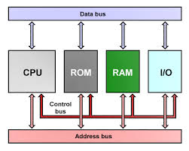
Components of a Computer and their Interconnections
Borahan Tümer, Ph.D.

Slide 3
Goals
We will learn methods of how to
  (explicit goal) organize or structure large amounts of data in the main memory (MM) considering efficiency; i.e,
    memory space and
    execution time
  (implicit goal) gain additional experience on
    what data structures to use for solving what kind of problems
    programming
Borahan Tümer, Ph.D.

Slide 4
Goals continued…1
Explicit Goal
  We look for answers to the following question:
  “How do we store data in MM such that
    execution time grows as slow as possible with the growing size of input data, and
    data uses up minimum memory space?”
Borahan Tümer, Ph.D.

Slide 5
Goals continued…2
As a tool to calculate the execution time of algorithms, we will learn the basic principles of algorithm analysis.
To efficiently structure data in MM, we will thoroughly discuss the
  static, (arrays)
  dynamic (structures using pointers)
  ways of memory allocations, two fundemantal
  implementation tools for data structures.
Borahan Tümer, Ph.D.

Slide 6
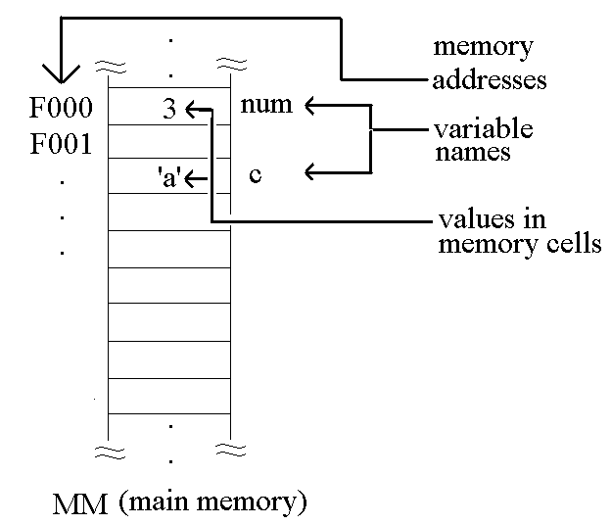
Representation of Main Memory
Borahan Tümer, Ph.D.

Slide 7
Examples for efficient vs. inefficient data structures
8-Queen problem
  1D array vs. 2D array representation results in saving memory space
  Search for proper spot (square) using horse moves save time over square-by-square search
Fibonacci series: A lookup table avoids redundant recursive calls and saves time
Borahan Tümer, Ph.D.

Slide 8
Examples for efficient vs. inefficient data structures
8-Queen problem (4-queen and 5-queen versions)
x
x
x
x
x
x
x
x
x
x
x
x
x
x
x
x
x
x
Borahan Tümer, Ph.D.

Slide 9
Examples for efficient vs. inefficient data structures
8-Queen problem (4-q and 5-q versions)
int a[4][4];
….
a[0][1]=1;
a[1][3]=1;
a[2][0]=1;
a[3][2]=1;
x
inefficient:
more memory
space (16 bytes
for 4-q version)
required
x
x
x
x
int a[5];
….
a[0]=0;
a[1]=2;
a[2]=4;
a[3]=1;
a[4]=3;
efficient:
less memory
space (5 bytes
for 5-q version)
required
x
x
x
x
Borahan Tümer, Ph.D.

Slide 10
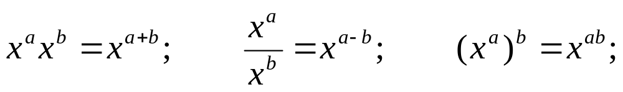
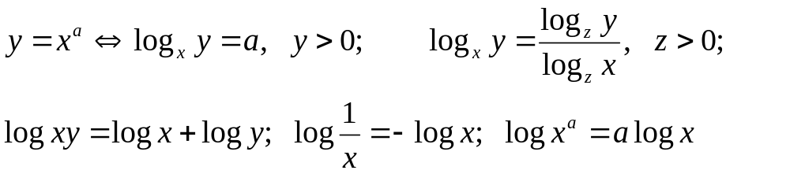
Math Review
Exponents
Logarithms
Borahan Tümer, Ph.D.

Slide 11
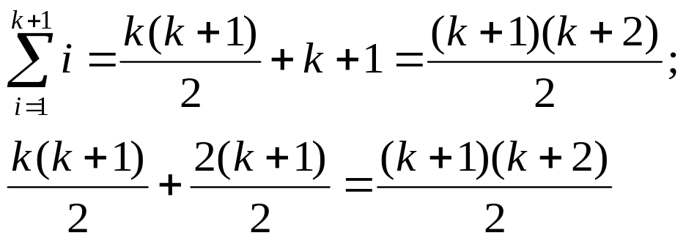
Math Review
Arithmetic Series: Series where the variable of summation is the base.
Borahan Tümer, Ph.D.

Slide 12
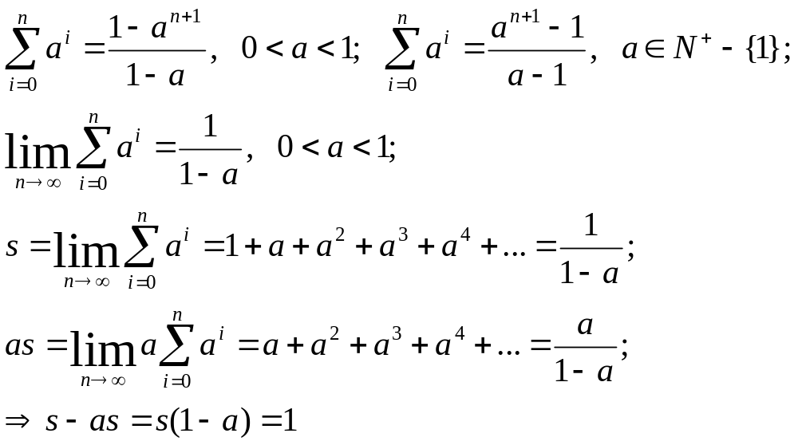
Math Review
Geometric Series: Series at which the variable of summation is the exponent.
Borahan Tümer, Ph.D.

Slide 13
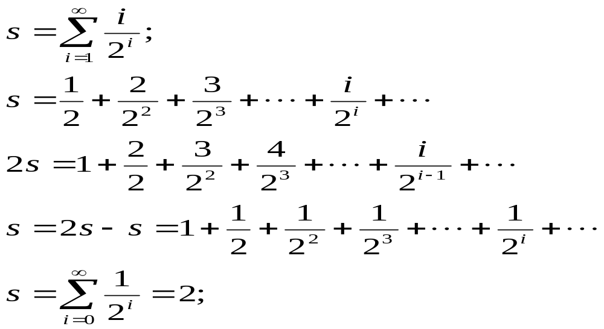
Math Review
Geometric Series…cont’d
An example to using above formulas to calculate another geometric series
Borahan Tümer, Ph.D.

Slide 14

Math Review
Proofs
  Proof by Induction
    Steps
      Prove the base case (k=1)
      Assume hypothesis holds for k=n
      Prove hypothesis for k=n+1
  Proof by counterexample
    Prove the hypothesis wrong by an example
  Proof by contradiction ( )
    Assume hypothesis is wrong,
    Try to prove this
    See the contradictory result
Borahan Tümer, Ph.D.

Slide 15
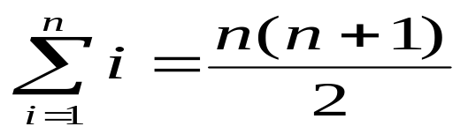
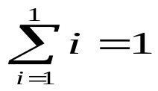
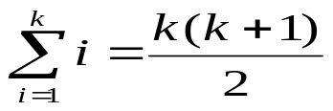

Math Review
Proof examples (Proofs… cont’d)
Proof by Induction
  Hypothesis
  Steps
    Prove true for n=1:
    Assume true for n=k:
    Prove true for n=k+1:
Borahan Tümer, Ph.D.

Slide 16
Arrays
Static data structures that
  represent contiguous memory locations holding data of same type
  provide direct access to data they hold
  have a constant size determined up front (at the beginning of) the run time
Borahan Tümer, Ph.D.

Slide 17

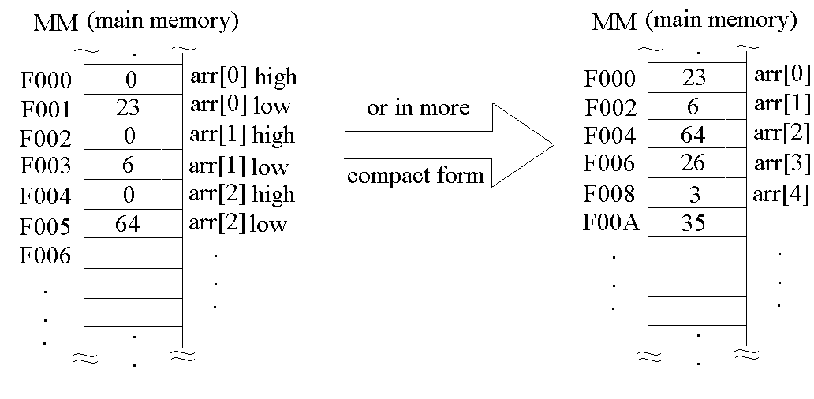
Arrays… cont’d
An integer array example in C
int arr[12]; //12 integers
Borahan Tümer, Ph.D.

Slide 18
Multidimensional Arrays
To represent data with multiple dimensions, multidimensional array may be employed.
Multidimensional arrays are structures specified with
  the data value, and
  as many indices as the dimensions of array
Example:
  int arr2D[r][c];
Borahan Tümer, Ph.D.

Slide 19
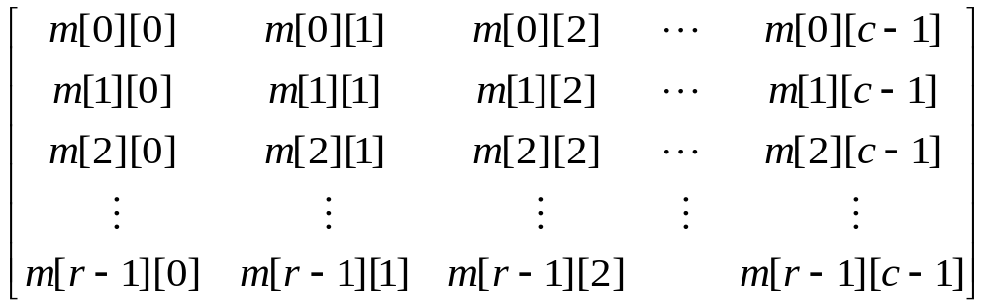
Multidimensional Arrays
m: a two dimensional (2D) array with r rows and c columns
Row-major representation: 2D array is implemented row-by-row.
Column-major representation: 2D array is implemented column-first.
In row-major rep., m[i][j] is the entry of the above matrix m at i+1st row and j+1st column. “i” and “j” are row and column indices, respectively.
How many elements? n = r*c elements
Borahan Tümer, Ph.D.

Slide 20
Row-major Implementation
Question: How can we store the matrix in a 1D array in a row-major fashion or how can we map the 2D array m to a 1D array a?
l elements
a
...
m[0][0]
...
m[0][c-1]
...
m[r-1][0]
...
m[r-1][c-1]
...
index: k →
k=l
k=l+c-1
k=l+(r-1)c+0
k=l+(r-1)c+c-1
In general, m[i][j] is placed at a[k] where k=l+ic+j.
Borahan Tümer, Ph.D.

Slide 21
Implementation Details of Arrays
Array names are pointers that point to the first byte of the first element of the array.
    double vect[row_limit];// vect is a pointer!!!
Arrays may be efficiently passed to functions using their name and their size where
    the name specifies the beginning address of the array
    the size states the bounds of the index values.
Arrays can only be copied element by element.
Borahan Tümer, Ph.D.

Slide 22
Implementation Details… cont’d
#define maxrow …;
#define maxcol …;
…
int main()
{
int minirow;
double min;
double probability_matrix[maxrow][maxcol];
… ; //probability matrix initialized!!!
min=minrow(probability_matrix,maxrow,maxcol,&minirow);
…
return 0;
}
Borahan Tümer, Ph.D.

Slide 23
Implementation Details… cont’d
double minrow(double darr[][maxcol], int xpos, int ypos, int *ind)
{// finds minimum of sum of rows of the matrix and returns the sum
// and the row index with minimum sum.
double mn;
…
mn=<a large number>;
for (i=0; i<=xpos; i++) {
sum=0;
for (j=0; j<=ypos; j++)
sum+=darr[i][j];
if (mn > sum) { mn=sum; *ind=i; } // call by reference!!!
}
return mn;
}
Borahan Tümer, Ph.D.

Slide 24
Records
As opposed to arrays in which we keep data of the same type, we keep related data of various types in a record.
Records are used to encapsulate (keep together) related data.
Records are composite, and hence, user-defined data types.
In C, records are formed using the reserved word “struct.”
Borahan Tümer, Ph.D.

Slide 25
Struct
We declare as an example a student record called “stdType”.
We declare first the data types required for individual fields of the record stdType, and then the record stdType itself.
Borahan Tümer, Ph.D.

Slide 26
Struct… Example
enum genderType = {female, male}; // enumerated type declared…
typedef enum genderType genderType; // name of enumerated type shortened…
struct instrType {
… //left for you as exercise!!!
}
typedef struct instrType instrType;
struct classType {// fields (attributes in OOP) of a course declared…
char classCode[8];
char className[60];
instrType instructor;
struct classtype *clsptr;
}
typedef struct classType classType; // name of structure shortened…
Borahan Tümer, Ph.D.

Slide 27
Struct… Example continues
struct stdType {
  char id[8]; //key
  //personal info
  char name[15];
  char surname[25];
  genderType gender; //enumerated type
  …
  //student info
  classType current_classes[10]; //...or class_type *cur_clsptr
  classType classes_taken[50]; //...or class_type *taken_clsptr
  float grade;
  unsigned int credits_earned;
  …
  //next record’s first byte’s address
  struct stdType *sptr; //address of next student record
}
Borahan Tümer, Ph.D.

Slide 28
Memory Issues
Arrays can be used within records.
  Ex: classType current_classes[10]; // from previous slide
Each element of an array can be a record.
  stdType students[1000];
Using an array of classType for keeping taken classes wastes memory space (Why?)
  Any alternatives?
How will we keep student records in MM?
  In an array?
  Advantages?
  Disadvantages?
Borahan Tümer, Ph.D.

Slide 29
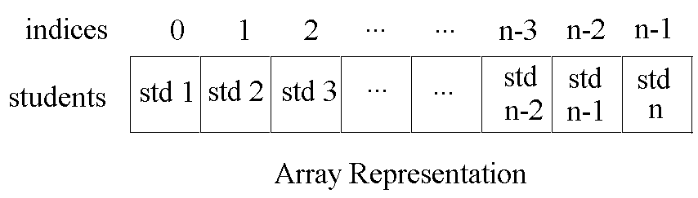
Array Representation
Advantages
Direct access (i.e., faster execution)
Disadvantages
Not suitable for changing number of student records
  The higher the extent of memory waste the smaller the number of student records required to store than that at the initial case.
  The (constant) size of array requires extension which is impossible for static arrays in case the number exceeds the bounds of the array.
The other alternative is pointers that provide dynamic memory allocation
Borahan Tümer, Ph.D.

Slide 30
Pointers
Pointers are variables that hold memory addresses.
Declaration of a pointer is based on the type of data of which the pointer holds the memory address.
  Ex: stdtype *stdptr;
Borahan Tümer, Ph.D.

Slide 31
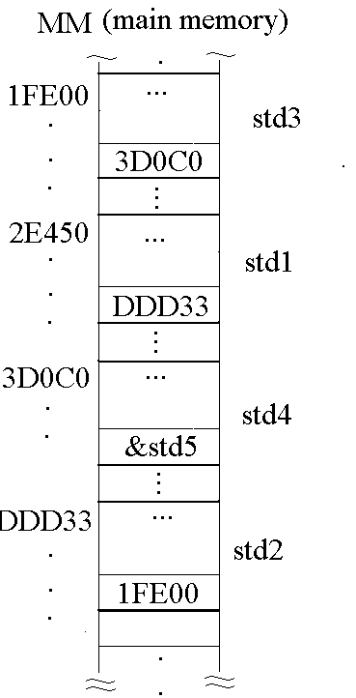
Linked List Representation
header
Std #1
Std #2
Std #3
Std #n
Memory heap
Std 2
Std n
header
Std 3
Std 1
Value of header=?
Value of header=2E450
Borahan Tümer, Ph.D.

Slide 32
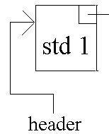
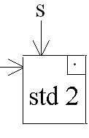
Dynamic Memory Allocation
header=(*stdtype) malloc(sizeof(stdtype));
//Copy the info of first student to node pointed to by header
s =(*stdtype) malloc(sizeof(stdtype));
//Copy info of second student to node pointed to by header
Header->sptr=s;
...
Borahan Tümer, Ph.D.

Slide 33
Arrays vs. Pointers
Static data structures
Represented by an index and associated value
Consecutive memory cells
Direct access (+)
Constant size (-)
Memory not released during runtime (-)
Dynamic data structures
Represented by a record of information and address of next node
Randomly located in heap (cause for need to keep address of next node)
Sequential access (-)
Flexible size (+)
Memory space allocatable and releasable during runtime (+)
Borahan Tümer, Ph.D.

